Slide 1

a
LIBRARY MANAGEMENT SYSTEM - OUTPUT

Slide 2
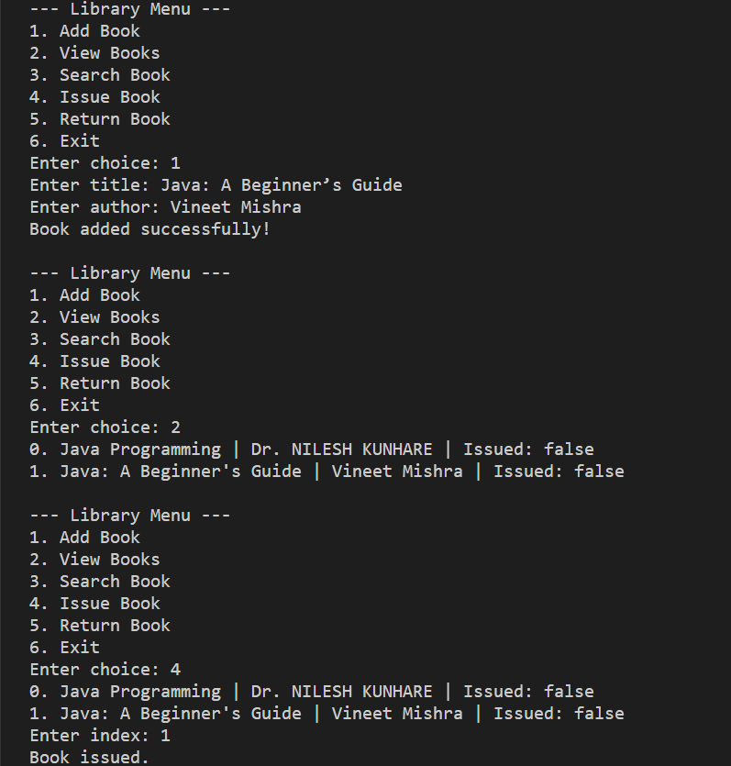
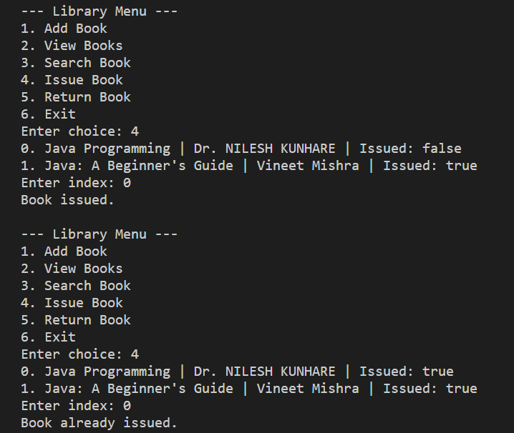
;
;

Slide 3




